Slide 1
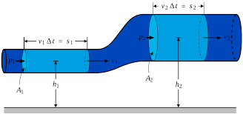
Medical physics- first year
Medical physics- first year
L10- Bernoulli's principle
Ass. Professor:- Mohammed Ali Jaber
Physiology Department
College of Medicine
University of Basrah
/25

Slide 2
Learning Objectives
By the end of this section, you will be able to:
The relation between pressure exerted by the heart and rate of flow
Bernoulli's principle
Continuity of flow equation
Bernoulli's principle application
How fast dose your blood flow
/25

Slide 3
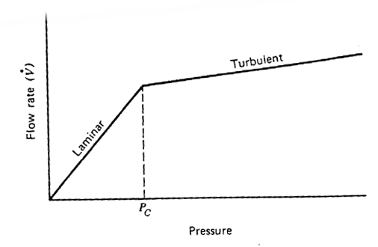
The relation between pressure exerted by the heart and rate of flow:
Turbulence increases the pressure required to drive a given flow.
At a given pressure, turbulence leads to a decrease in flow.
$∆$Q2
$∆$Q2
$∆$Q1=$∆$Q2
$∆$P2>> $∆$P1
$∆$Q1
$∆$Q1>$∆$Q2
$∆$P2= $∆$P1
$∆$P1
$∆$P2
$∆$P2
/21

Slide 4
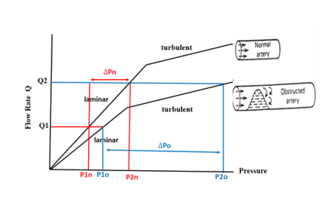
laminar flow is more efficient than turbulent flow.
In an obstructed artery the pressure needed to produce a given flow rate is greater than in normal artery of the same size.
/21

Slide 5
Bernoulli's principle
Bernoulli's principle is based on the law of conservation of energy.
-Pressure in a fluid is a form of potential energy(PE) (it has the ability to perform useful work)
PE =(ρgh)
-In a moving fluid there is kinetic energy KE due to motion (energy \volume) . KE= (½ρv²)
/25

Slide 6
P +$ρg$h + $\frac{1}{2} ρ v_{ }^{2}$ = Constant
Pressure decreases
Pressure increases
Velocity reduces
Velocity increases
The kinetic energy is converted back into potential energy
Increased in kinetic energy KE
reduction of the potential energy
/25

Slide 7
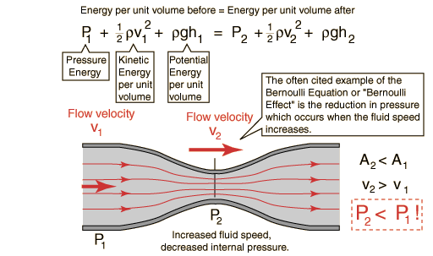
Bernoulli’s equation tells us that when velocity increases, the pressure (that the fluid exerts on its walls) decreases.
/25

Slide 8
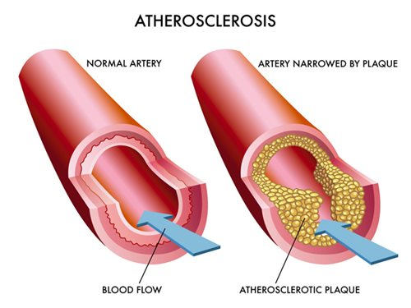
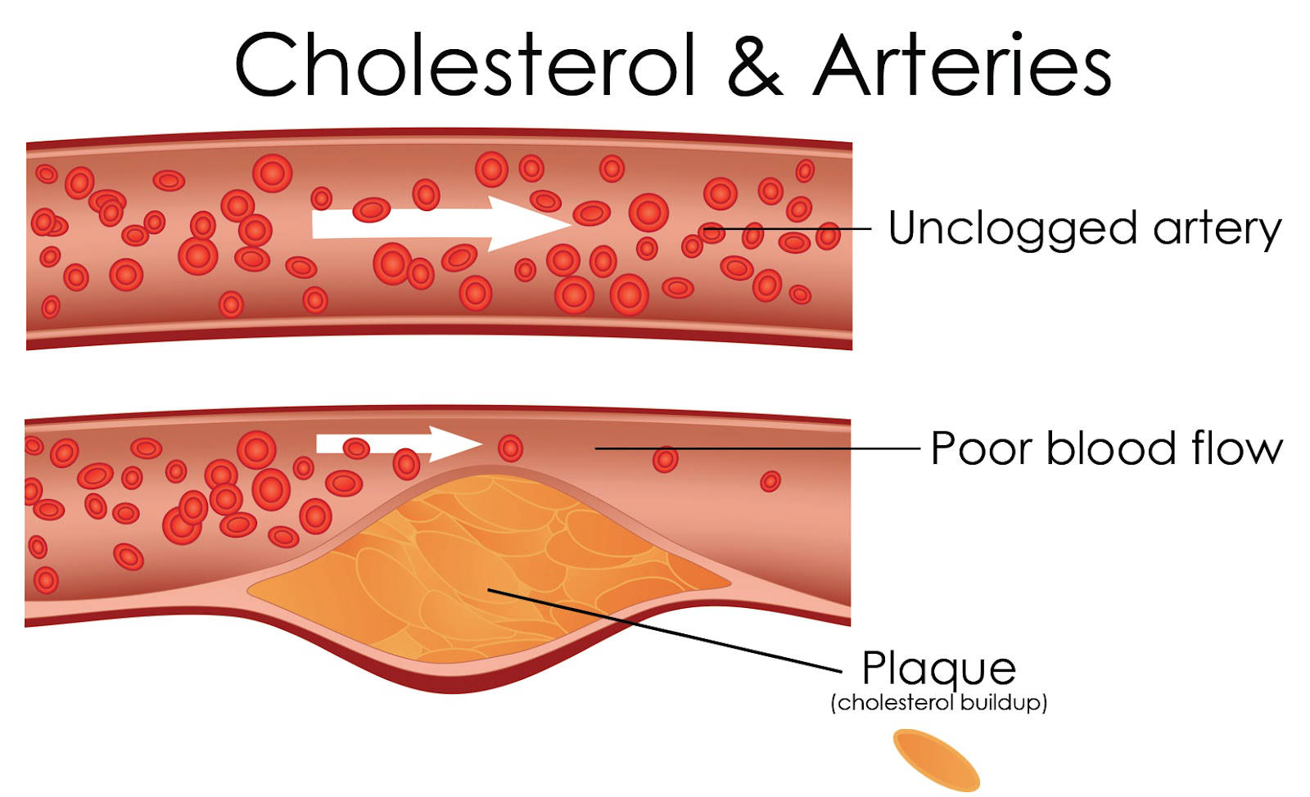
When you have cholesterol buildup and arteriosclerosis, then the arteries decrease in area since the radius is smaller.
/25

Slide 9
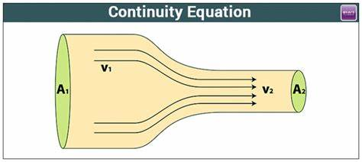
Continuity of flow equation
Continuity of flow equation tells us this: when the area decreases, the velocity increases in order to maintain a constant flow rate.
Q =A₁V₁=A₂V₂
/25

Slide 10
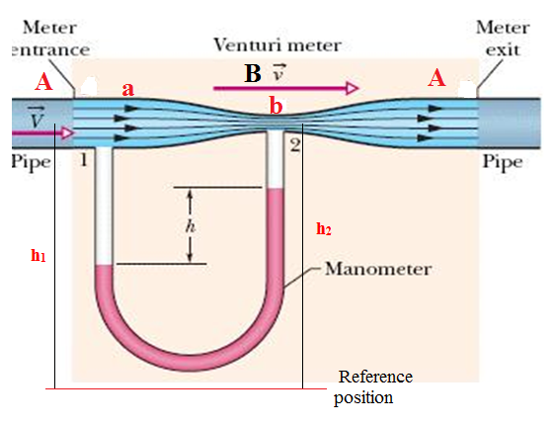
Bernoulli's principle application
Venturimeter:
The flow speed of incompressible fluid can be measured using a device called venturimeter. It works on Bernoulli’s principle.
/25

Slide 11
The potential energy at reference position is :
$ρg$h₁= $ρg$h₂
The speed $v_{1}$ of the liquid flowing through the tube at the broad neck area A is to be measured from equation of continuity.
$a v_{1}$=b$v_{2}$
Speed at the constriction becomes v₂
$$v_{2}=\frac{a}{b} v_{1}$$
Then using Bernoulli's equation, we get:
P₁+$ρg$h₁ + $\frac{1}{2} ρ v_{1}^{2}$ = P₂+$ρg$h₂ + $\frac{1}{2} ρ v_{1}^{2}(\frac{a}{b} ) ^{2}$
So that P₁ - P₂ = $\frac{1}{2} ρ v_{1}^{2}[\left(\frac{a}{b} \right) ^{2}−1]$
/25

Slide 12
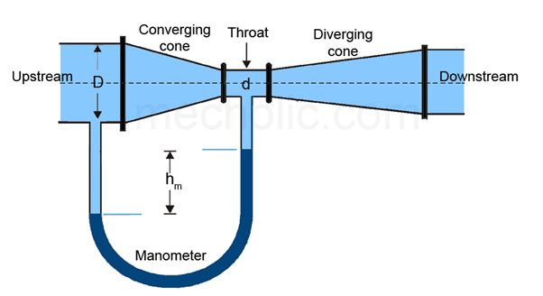
The differences in height h measure the pressure difference.
P₁ - P₂ = $ρ_{m }gh$= $\frac{1}{2} ρ v_{1}^{2}[\left(\frac{a}{b} \right) ^{2}−1]$
So that the speed of fluid at wide neck is:
${ v}_{1}= \sqrt[ ]{\frac{2ρ_{m }gh }{ρ }}$ $[\left(\frac{a}{b} \right) ^{2}−1] ^{\frac{−1}{2}}$
$ρ$ : fluid density
ρ_{m} : density of manometer liquid
h : height difference between the fluid on the 2 sides of the "U"
g : gravitational acceleration constant.
a & b: the cross-sectional areas at position A & B respectively,
By knowing the difference in height (h) the velocity v can be calculated.
/25

Slide 13
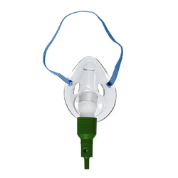
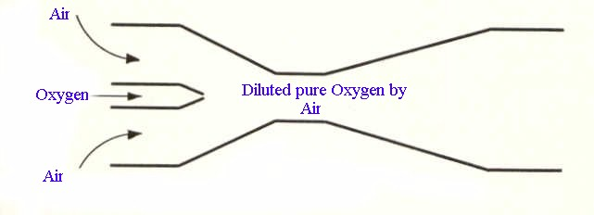
Venturi Tube Application(principle of injection)
Which has the effect of pulling air molecules into the higher speed stream.
Relative reduction in pressure associated with the higher oxygen velocity
Friction between the high-speed oxygen molecules in the lower speed air molecules
/25

Slide 14
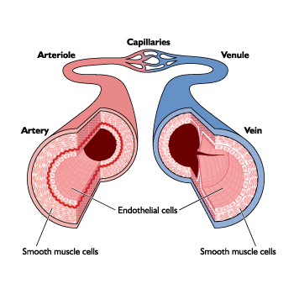
How fast dose your blood flow
The blood goes from the aorta into the smaller arteries and arterioles with greater total-cross-sectional areas the velocity of the blood decreases
Velocity = blood flow/ area
The average velocity in the aorta 30cm/s; that in a capillary is only about 1mm/s, this low velocity allows time for diffusion of gases to occur
/25

Slide 15
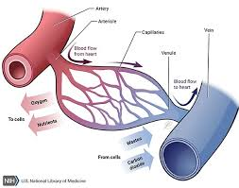
We can calculate the average kinetic energy per unit volum of 1gm(cm3) of blood as leaves the heart.
KE=1/2mv² since average velocity=30cm/s
KE= 1/2 x1x 30² =450 ergsThis kinetic energy is equivalent to a potential energy 450 dyne/cm²,
Kinetic energy density = (450 )ergs/cm3
Since a pressure of 1mmHg corresponds to 1330 dyne/cm², this potential energy amounts(450 ergs) to less than 0.4mmHg
/25

Slide 16
The smallest blood vessels are the capillaries(~20µm in diameter)and there are millions of them,
The total cross-sectional area=30 cm in diameter.
V in the aorta=30 cm/sec ,
V in a capillary =1 mm/sec (exchange of O₂ and CO₂).
/25

Slide 17
